Slide 1
CIS602-01
Computational Reproducibility
Project Presentation
On
Spectral Matting
(Anat Levin, Alex Rav-Acha, Dani Lischinski)
Ankita Anil
01592435

Slide 2
Introduction
What is Matting ?
Matting can be defined as the process of extracting a foreground object of an image along with an opacity estimate for each pixel covered by the object. This process enables compositing the extracted over a new background.
Applications ?
Digital matting enables compositing the extracted object on a new background.
It is widely used in the following fields:
1. Image editing tools
2. Video production tools
3. It is used to add special effects in motion pictures.

Slide 3
Introduction
What is Spectral Matting?
It is a new approach to Digital Matting, that automatically computes a set of fundamental fuzzy matting components from the smallest eigenvectors of a Laplacian Matrix.
Some Important Terms
Laplacian Matrix
In image processing, a Laplacian matrix is simply a matrix representation of a graph of an image, where each node represents a matting components and the edge weights indicates the matting penalty.
Eigenvectors
A vector when operated on by an operator, gives a scalar multiple of itself.

Slide 4
Introduction
Previous approaches to Segmentation and Matting:
Spectral Segmentation Technique
The approach extracts hard segments and performs unsupervised image segmentation by exploring the smallest eigenvectors of the image’s graph’s Laplacian Matrix.
Spectral Matting is greatly influenced my segmentation technique, but extracts soft matting components, which are then used as building blocks to construct the matte for a foreground object.
Further mattes can be produced in two fashions:
1. Unsupervised Matting
2. User-Guided or Supervised Matting with little user input.

Slide 5
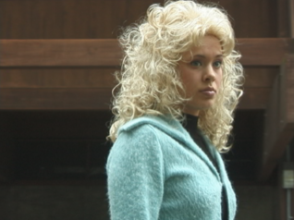

Introduction Previous approaches to Segmentation and Matting…
Input
Hard output
Matte output
Unsupervised
Spectral segmentation: Shi and Malik 97 Yu and Shi 03 , Weiss 99 , Ng et al 01, Zelnik and Perona 05 , Tolliver and Miller 06
Notes:
Comparison between the two approaches, the old hard segmentation technique and the spectral matting..

Slide 6
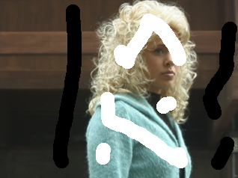
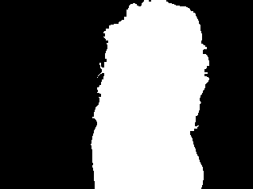
Introduction Previous approaches to Segmentation and Matting…
Input
Hard output
Matte output
Unsupervised
Supervised

Slide 7
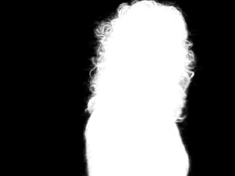
Introduction Unsupervised Matting
Input
Hard output
Matte output
?
Unsupervised
Supervised
Notes:
Matte output for unsupervised matting is generated by the approach explained in the paper which is Component matting, and the components are generated automatically.
Alpha---- 1 means opaque, 0 means transparent.

Slide 8
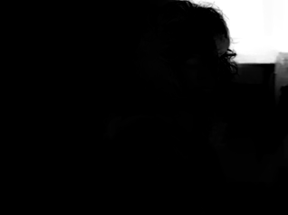
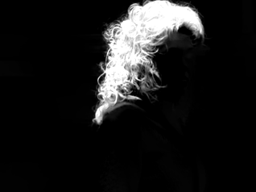
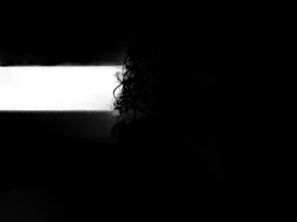
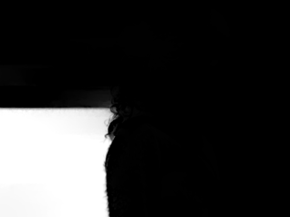
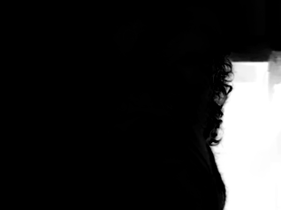
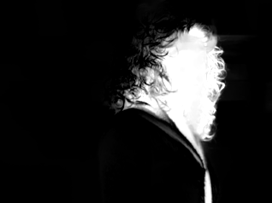
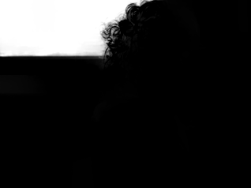
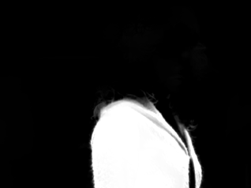
Introduction Component Selection Example
Input
Automatically computed hard segments (Yu and Shi 03)
Automatically computed matting components

Slide 9
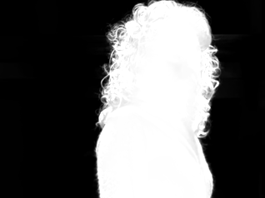
Introduction Component Selection Example
The foreground matte object for Unsupervised matting is built by simple component selection and addition.
+
+
=

Slide 10
Introduction Compositing Equation
In matting algorithms, each pixel I_{i} in an input image is a linear combination of-
Foreground color F_{i}
Background color B_{i}
The comositing equation:
I_{i} =α_{i}F_{i} + (1−α_{i})B_{i}
It is assumed each pixel is a convex combination of K image layers.
Therefore, α^{K} = Matting Component

Slide 11
Goals
Automatically extracting matting components from an image.
Deriving an analogy between hard spectral segmentation and matting, and use similar tools.
Use matting components to automate the matte extraction process and suggest new modes of user interaction.

Slide 12
Reproducibility Materials Available
The code is available for download at Spectral Matting page on http://www.vision.huji.ac.il/SpectralMatting/ .
The spectral Matting Code folder contains MATLAB code in the form of functions and scripts.
runAll.m file re-creates all the examples from the paper on unsupervised matting and generates the following:
alpha matte of the image
all the matting components of an input image
the results for unsupervised matting
all candidates for alpha matte
and the best alpha matte of the image which is same as the alpha matte.
Notes:
Matlab code, ground truth data, supp , technical report

Slide 13
Reproducibility Materials Available
The spectralMattingCode folder also contains two already MATLAB formatted data files, scribbles.mat and my_images.mat, which are loaded into runAll.m file for implementation.
There are C++ programs to implement the concept of minimum cut and maximum flow algorithm on two types of graph representation, i.e. Adjacency List and Forward Star.
Ground truth data was also made available on the above mentioned site.
There were Supplementary Materials available too on the site, which included only images from the spectral Matting paper and some of the results on unsupervised matting.
There was an additional pdf file on technical report of the paper.

Slide 14
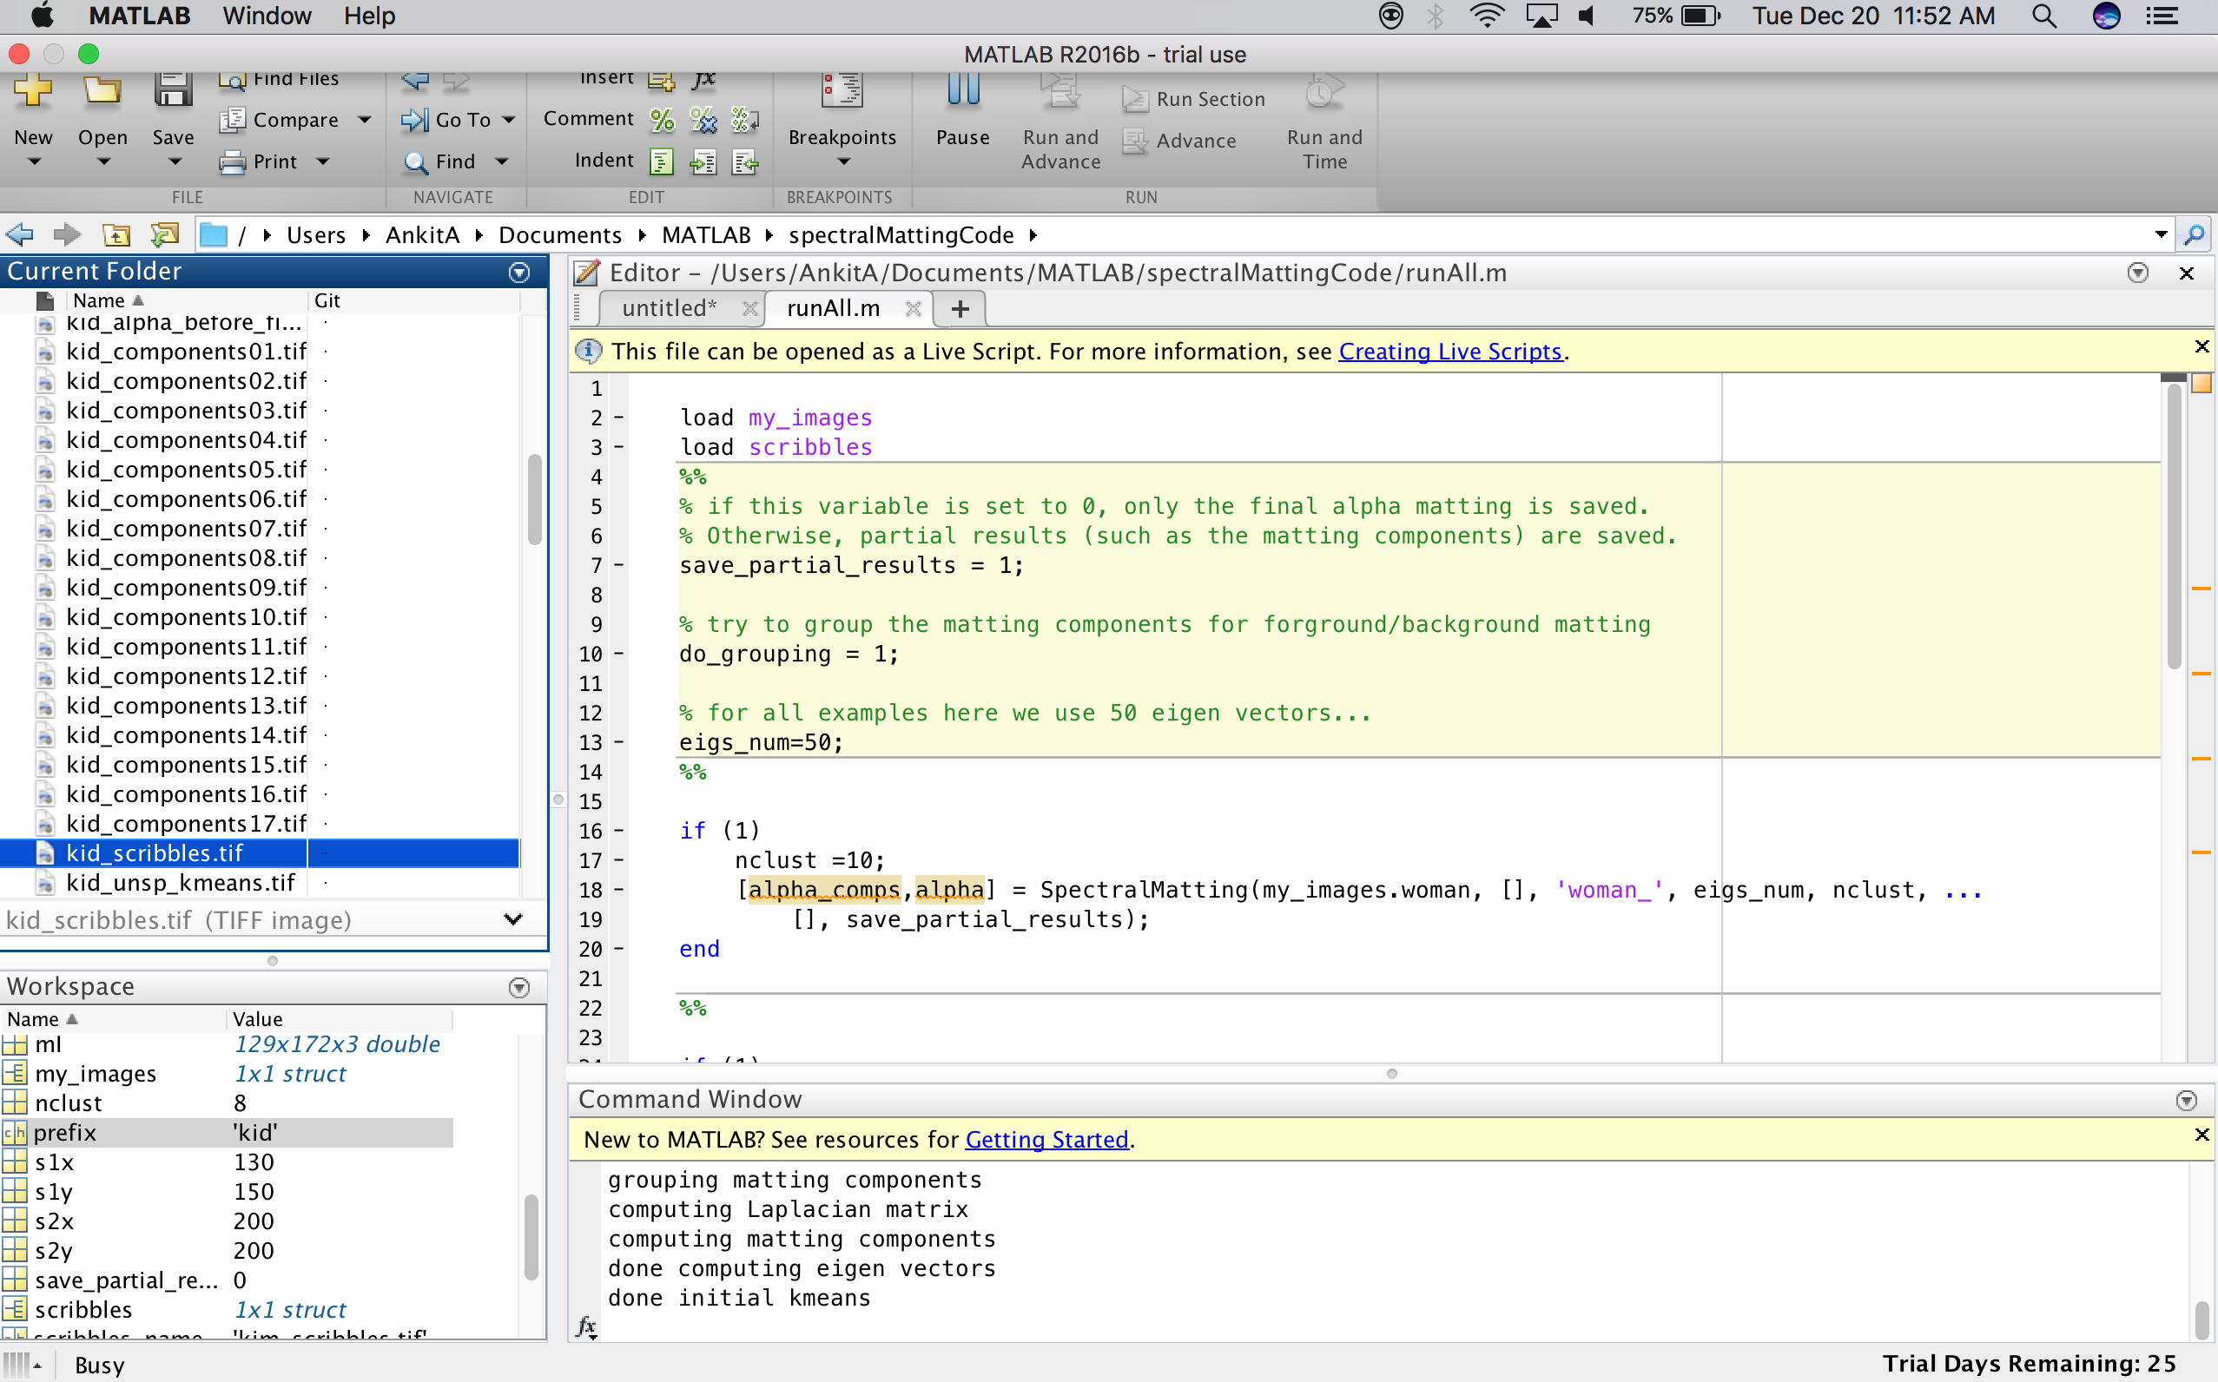
Experiment
Executing runAll.m file on Matlab.
DEMO
Notes:
demo

Slide 15
Results Reproduced
Following are some of the results that have been reproduced from the paper:
The runAll.m file generated the component images, alpha matte and unsupervised matte of the input image kim.tif, which is Figure 1 in the paper Spectral Matting.
Input Image

Slide 16
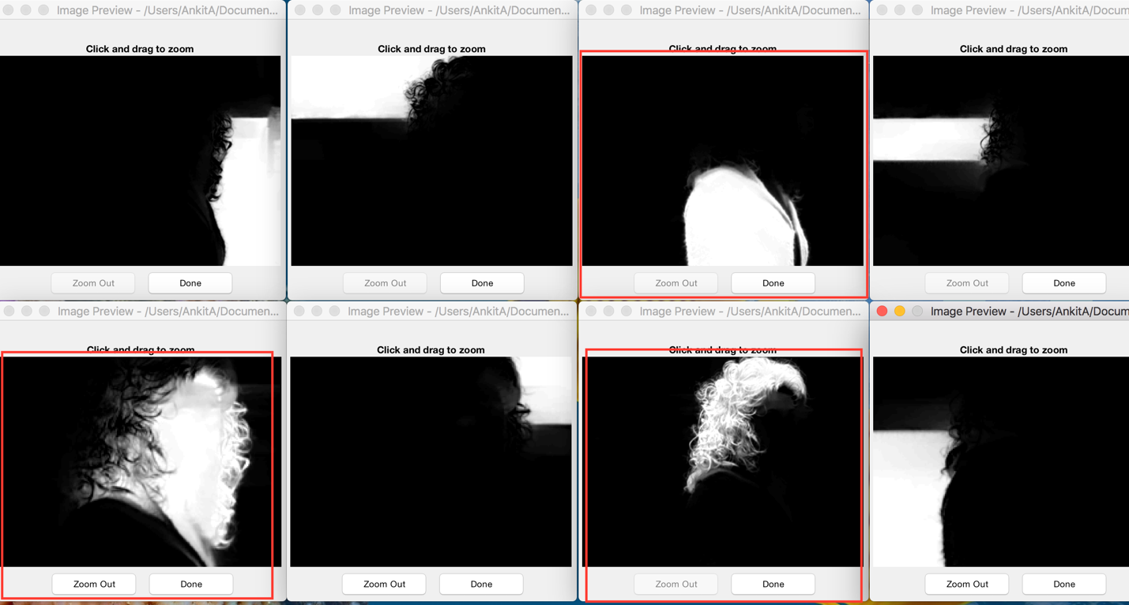
Results Reproduced Figure 1 of paper..
Following are the 8 matting components produced:
The components in red borders are combined together to form the Alpha matte of the foreground object

Slide 17
Results Reproduced Figure 1 of paper..
Alpha Matte produced
Unsupervised hard segmentation Output:

Slide 18
Results Reproduced Figure 3 of paper..
Figure 3 from the paper Spectral Matting depicting unsupervised matting for two images i.e. face.tif and woman.tif have been
reproduced along with all the candidates for alpha matte as shown in the figure.
Input image face.tif
Alpha matte for face.tif

Slide 19
Results Reproduced Figure 3 of paper..
All the candidates for Alpha Matte generated in this part of experiment:

Slide 20
Results Reproduced Figure 3 of paper..
Input image- woman.tif
Alpha Matte for woman.tif

Slide 21
Results Reproduced Figure 3 of paper..
All the candidates for Alpha Matte generated in this part of experiment-

Slide 22
Results Reproduced Figure 4 of paper…
Figure 4 from the paper Spectral Matting depicting comparison of mattes produced by different matting methods from
minimal user input, were reproduced only for the results of the approach presented in this paper.
Scribbles is a form of user-guided matting, where foreground matte is extracted from an image based on a small number of
white markings on foreground and black markings on the background.
Input original and scribble image:
Image kim_scribbles.tif
Matte generated

Slide 23
Results Reproduced Figure 4 of paper…
Input original and scribble image:
Image wind_scribbles.tif
Matte generated

Slide 24
Results Reproduced Figure 4 of paper…
Input original and scribble image:
kid_scribbles.tif
Matte generated

Slide 25
Conclusions
All the codes and the input images provided in the Spectral Matting code folder were quite useful in
re-creating all the examples mentioned in the paper explaining the concepts of matting.
However, due to unavailability of the codes for four other matting algorithms mentioned in Figure 7,
the bar graph on SSD Errors between different mattes were not implemented as well as mattes produced
in the last four columns of Figure 4.

Slide 26
Conclusions Conclusions inferred from the paper
1. An analogy was derived between hard spectral image segmentation and image matting.
2. Paper showed how fundamental matting components are automatically extracted from the smallest eigenvectors of the matting Laplacian matrix.
3. It showed how matting components can help in automating the matte extraction process and reduce user effort.
4. It also showed how matting components enable user control and interaction over extracted matte, as generating matting components provide user with preview of optional outputs where user can directly control the outcome of the mattes.

Slide 27
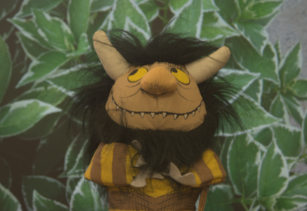
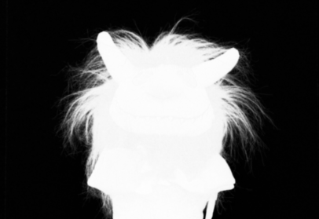
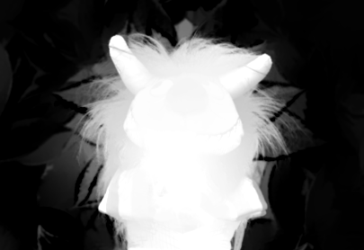
Limitations As inferred from the paper
In case of highly cluttered images, the process of component extraction becomes quite a challenging task, as cluttered images
require a large number of matting components which in turn comes from large number of smallest eigenvectors because there
exists a linear transformation between them.
Ex.
Another major challenge of spectral matting is determining the appropriate number of matting components for an image.
If the matting components are too few, then it may not contain the desired matte; and if there are too many, then it complicates
the computation and user interaction.
Input
Ground truth matte
70 eigs approximation

